Slide 1


DEFECT DETECTION MODEL
AI
SUPERVISED BY
DR. AHMED SHAWKY MOUSSA
TA. ANDREW MAHER
IMPLEMENTED BY
AHMED GAMAL 20190021
AHMED ADEL 20190042
HASNAA MOUNIR 20190180
ZEYAD MAHER 20190224
MENNATULLAH RASHED 20190554

Slide 2
Table of contents
01
Introduction
03
Project specifications
02
Limitations
04
Conclusion
01
03
02
04

Slide 3
01
Introduction
A Brief Introduction to the Project Concept

Slide 4
Introduction
As the American Society of Quality reports [1], many organizations have quality-related costs of up to 40% of their total production revenue.
This has led to the integration of AI in the field, as human beings have limited ability to detect manufacturing defects and subtle errors.
40%
[1]
https://asq.org/quality-resources/cost-of-quality#:~:text=Many%20organizations%20will%20have%20true,10%2D15%25%20of%20operations.

Slide 5
Project Idea
MISSION
IDEA
developing a more efficient and accurate way of defect detection model.
Developing a Real-Time Model to Detect Defects and Initiate Appropriate Actions
VISION
SCOPE
developing system that can scan products and validate their quality.
the manufacturing industry where ensuring product quality is crucial to success.

Slide 6
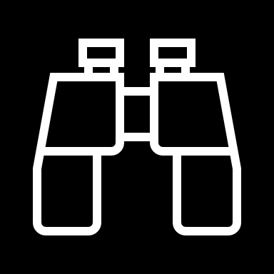
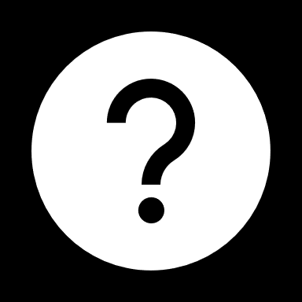
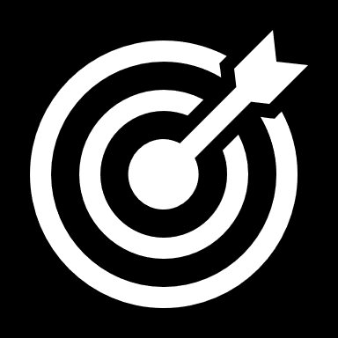
Domain of Interest
Utilization
AI, deep learning, and computer vision
Focus
Objective
Aiming to enhance quality control processes, and overall product reliability in manufacturing
Focusing on the manufacturing industry.
Distinguishes between good and defective products.
By analyzing a single product per frame.
.

Slide 7
Expected Benefits
Minimize quality-related costs and maximize production revenue.
Enhance defect detection accuracy and efficiency compared to existing solutions.
Enable proactive identification and take an action
Promote locality and support local brands.

Slide 8








SOFTWARE
Python
tensorflow
Flask
Flutter
Google Colab
Android studio

Slide 9
02
Limitations
Addressing challenges, we faced in the Architecture designing

Slide 10
Object Detection Challenges
Previous model
Optimized model
January
MobileNet SSD
Higher speed for real-time
Model Maker
Very slow for real-time
Low accuracy

Slide 11
Classification Challenges
Previous model
Optimized model
January
VGG-16
High accuracy, it's 99%
Random CNN architecture
Low accuracy
High complexity

Slide 12
Flutter Challenges
Previous model
Optimized model
January
TFLite package
Low accuracy
backend server
High accuracy

Slide 13
03
Project specifications
Elaborating on the Model Implementation

Slide 14
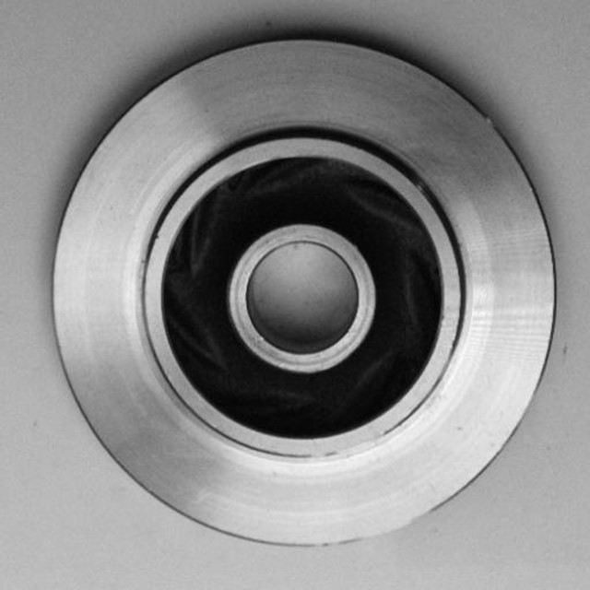
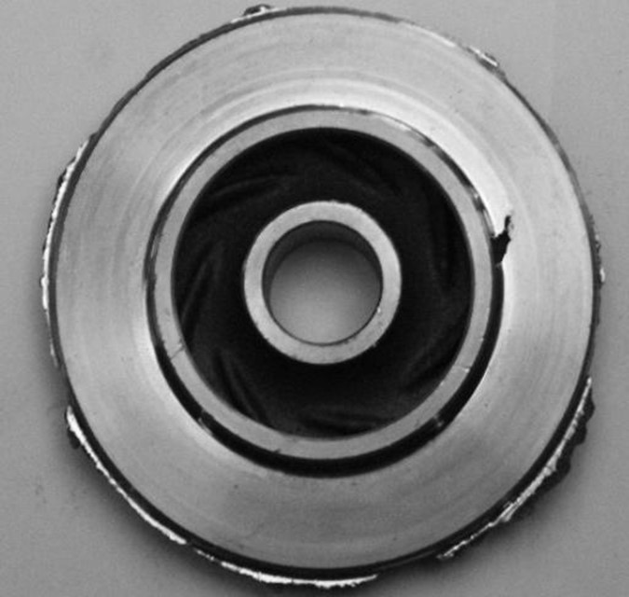
DATASET
Size: 10.000 images
Type: Casting Products
Characteristics: The products move in the production line one by one, so each frame will contain only one product.
Non-defect
Defect

Slide 15
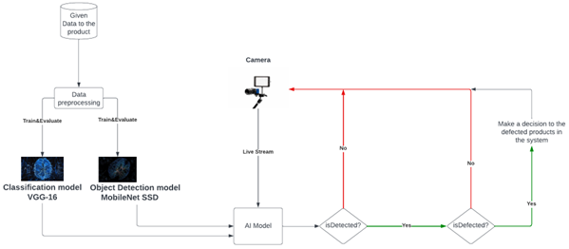
System Architecture
Given Data to the product
Camera
Data preprocessing
Train & Evaluation
Train & Evaluation
Make a decision to the defected products in the system
Live Stream
No
No
Classifivation model VGG-16
Object Detection model MobileNet SSD
isDetected?
isDetected?
Yes
AI Model
Yes

Slide 16
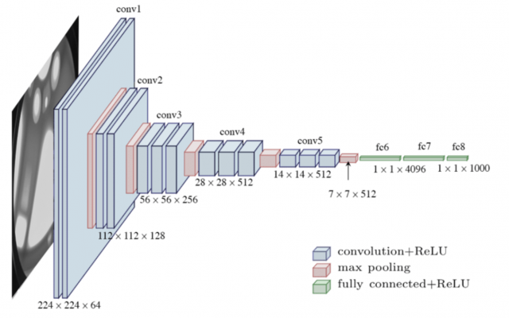
CNN Architecture
Visual Geometry Group (VGG-16)
Successful CNN Architecture, Well Understand, acceptable to implement. using 13 Convolution + 3 fully connected + 5 max-pooling layers

Slide 17
Classification model VGG-16 from scratch --failed
A randomly designed architecture may not generalize well and yield poor results with new images.
We tried training a CNN VGG16 architecture from scratch using platforms like Google Colab and Jupyter Notebook. However, limited resources hindered us from achieving the desired outcome.

Slide 18
SSD MobileNet Model by TensorFlow
MobileNet is A CNN architecture for building object detection models
MobileNet
SSD is a Single Shot Detector, uses MobileNet as a backbone for object detection
SSD

Slide 19
Advantages of MobileNet SSD
02
Used for embedded devices or mobile
01
03
Lightweight model
Balance between speed and accuracy

Slide 20

Mobile Application:
WHY?
Develop an interface to the system using Flutter.
Simulate deploying the model for an IoT system as an embedded device
Used for fixed products
Plant Examination Solar Energy Cells

Slide 21
Deploy with Mobile APP
Flask
ngrok server

Slide 22
04
Conclusion

Slide 23

Conclusion
Achieving the objective of the project
Real Time
Data Extraction
Functional & Non-functional
Requirements
Mobile Application
Agile

